Slide 1

Abnormal Vaginal Bleeding
NZNO Women’s Health College Conference 26-28 May 2022
Te Pae Christchurch
Dr Joanna Knight
Obstetrician & Gynaecologist
Lead for Colposcopy, Hysteroscopy and Triage
Christchurch Women’s Hospital

Slide 2

What is “abnormal bleeding”?
Infrequent periods (oligomenorrhoea)
Bleeding between periods (intermenstrual bleeding, IMB)
Bleeding with sex (including postcoital bleeding, PCB)
Frequent bleeding (<21 day cycle, persistent bleeding with no pattern)
Heavy bleeding
Prolonged periods
Bleeding after menopause (>12 months without bleeding, PMB)
Vulval, Urinary tract or PR bleeding mistaken for vaginal bleeding
NICE 2018: Heavy menstrual bleeding is excessive blood loss which interferes with physical, emotional, social and material quality of life. It can occur alone or in combination with other symptoms

Slide 3
Focus on abnormal uterine bleeding (AUB) in premenopausal women
Common, up to 1/3 over lifetime
All age groups affected but causes can vary with age and can be more than one co-existing
2018 FIGO classification of causes
  Structural
  Non-structural
Additional symptoms might suggest the cause
Investigations
Treatments
Slightly different pathways for PCB and PMB

Slide 4
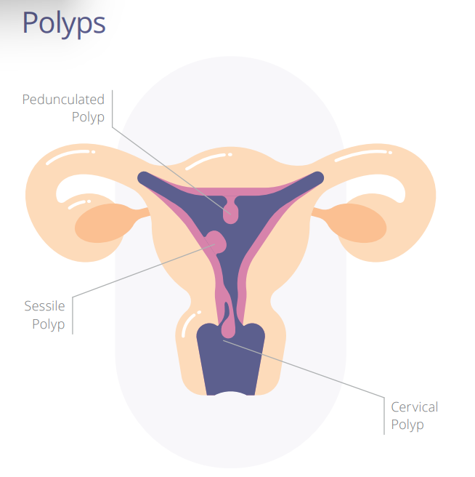
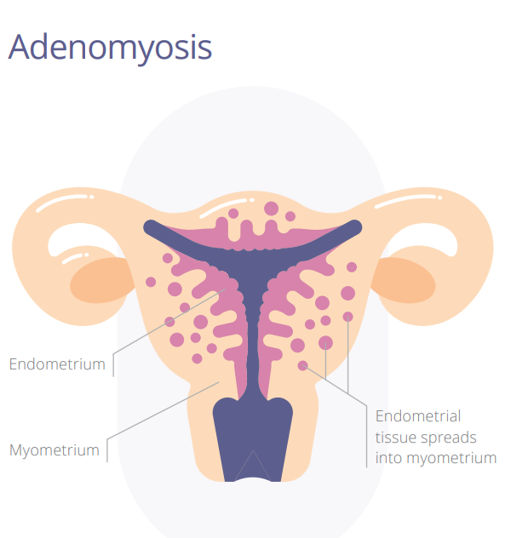
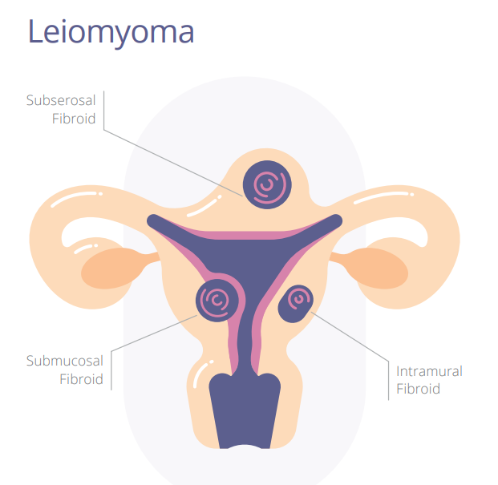
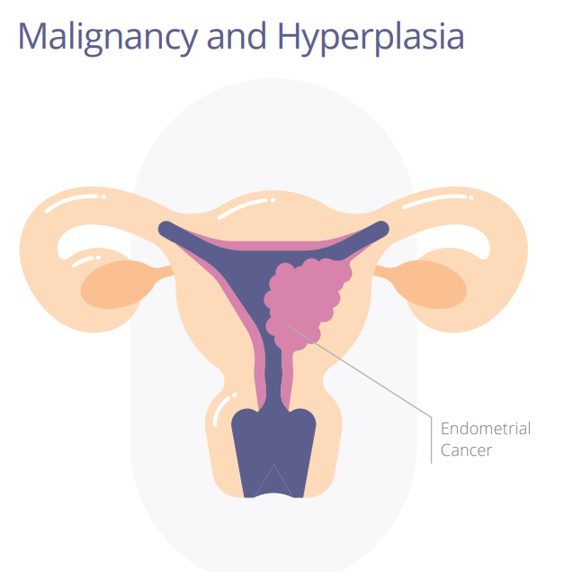
FIGO 2018
PALM-COEIN
Structural
  Polyps
  Adenomyosis
  Leiomyoma (fibroids)
  Malignancy & Hyperplasia
Images taken from HELP Group/Bayer
https://www.heavymenstrualbleeding.com/sites/g/files/vrxlpx3036/files/2020-10/PALM-COEIN_classification_PDF-06.pdf

Slide 5
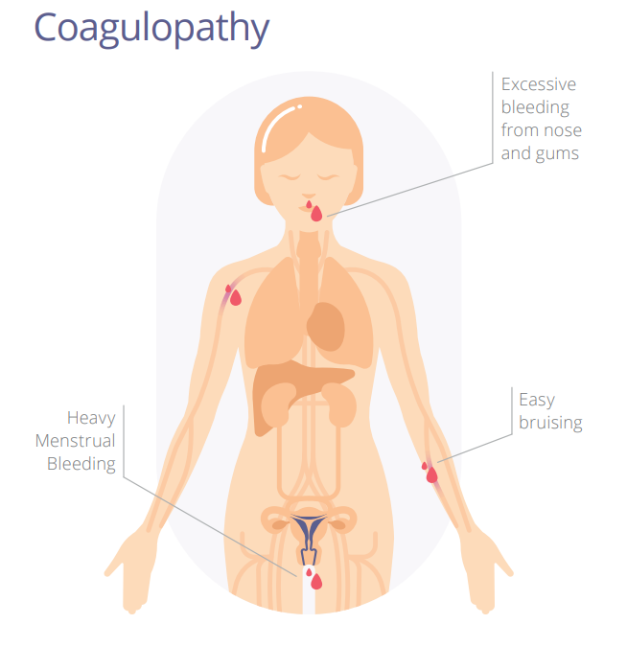
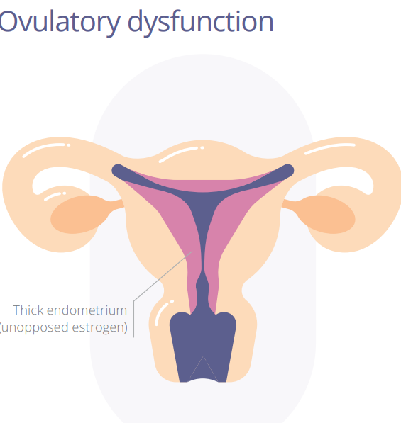
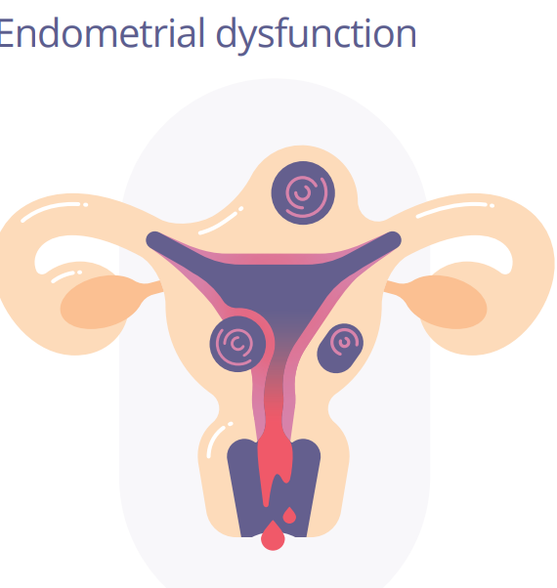
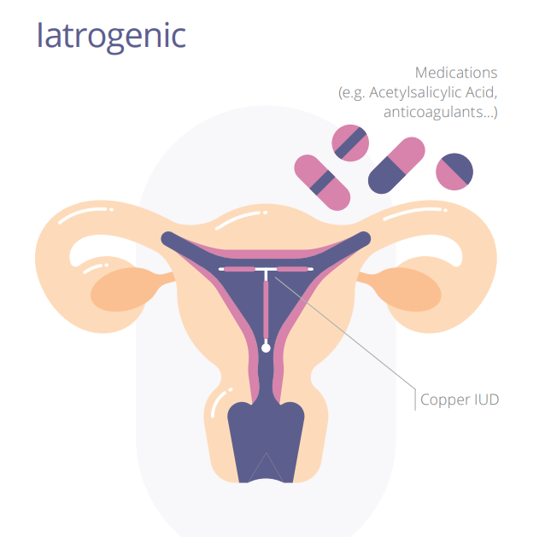
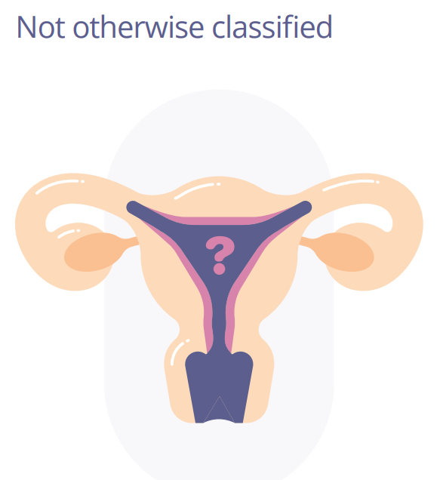
  FIGO 2018
  PALM-COEIN
Non structural
    Coagulopathy
    Ovulatory dysfunction
    Endometrial dysfunction
    Iatrogenic e.g. medications
    Not otherwise classified (other causes excluded)

Slide 6
History
Pattern of bleeding/IMB/PCB, is this new?, impact on life
Clarify flow e.g. how frequently change products, double protection, clots, flooding
Pregnancies, fertility wishes, contraception
STIs, cervical screening
Associated symptoms e.g. bruising/bleeding, anaemia, pain, bowels/bladder
PMH, medications
Family history

Slide 7
Examination
General, thyroid, anaemia etc
Abdomen and pelvic exam
Abdominal mass
Bulky uterus or pelvic mass
+/- swabs
+/- Cervical smear
+/- Pipelle endometrial biopsy (or later)

Slide 8
Investigations
Pregnancy test
Blood tests
CBC
TSH if thyroid symptoms
Ferritin
+/- reproductive hormones
+/- coag studies
Pipelle biopsy if not already performed
45y+
35y+ and risk factor/s
Larger body size, ethnicity, diabetes, family history, PCOS, nulliparous
Pelvic USS
Depends on local healthpathway if funded in community
CDHB: uterus palpable abdominally, pelvic mass on bimanual, not responded to medical therapy, persistent IMB, abnormal Pipelle or unable to obtain/insufficient

Slide 9
Management - not cause specific
Primary care
  Treat anaemia
  Non-hormonal
    TXA and NSAIDs
  Hormonal
    Contraceptives
      COCP
      POP, Cerazette, Depo Provera
    Cyclical norethisterone/Provera
    IUS Mirena (Jaydess)
Refer for gynaecology/hysteroscopy
  Unable to obtain Pipelle/insert IUD
  USS suggestive of polyps
  Pipelle result abnormal e.g. hyperplasia, malignancy
  Large fibroids if not responded to med tx or additional factors such as pressure symptoms, subfertility
  Unsuccessful medical tx
  Other -

Slide 10
Outpatient hysteroscopy
Pre and post menopausal abnormal bleeding
Incidental abnormalities on imaging
IUD – e.g. lost threads, difficult removals

Slide 11
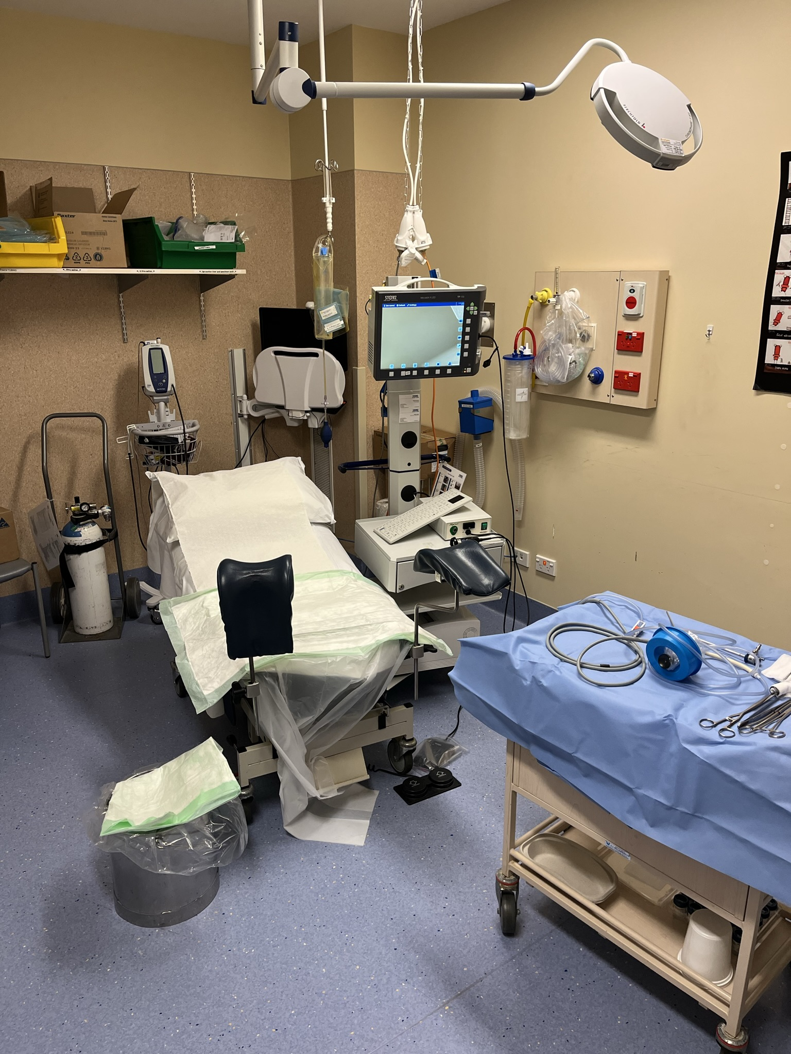
CDHB set up
Two nurses – one pre and post procedure, and one in the room
Own clothes, less “clinical” than OT, fewer instruments set up
Support person
Options for oral sedation, local anaesthetic, Entonox
“Vocal local”, breathing techniques, stress balls
Mirena insertion
Different types of hysteroscope
  Omniscope for most patients
    Narrow 3.7mm – 5.5mm oval
    Excellent views
    Changeable operating sheath for Myosure tissue removal
    Commonly one visit
  Trophy scope 4mm – 5mm
    Diagnostic or for using graspers or scissors
    Mostly now used for IUD retrieval
    Directed endometrial biopsy
    Polypectomy

Slide 12
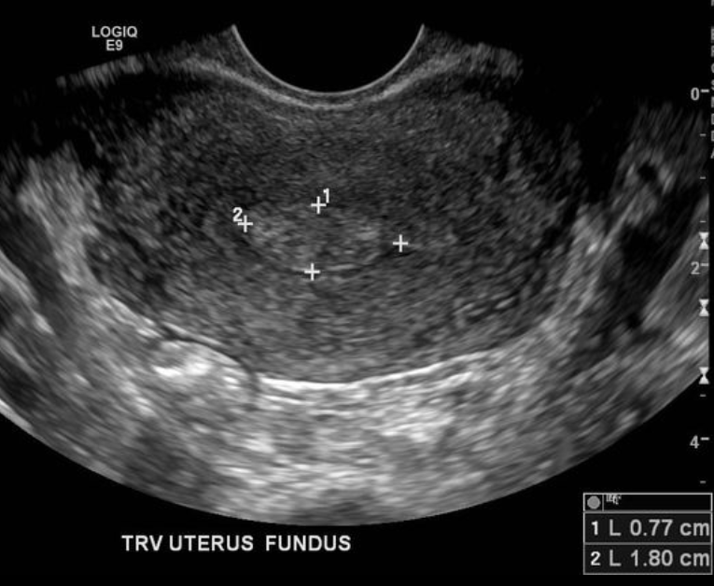
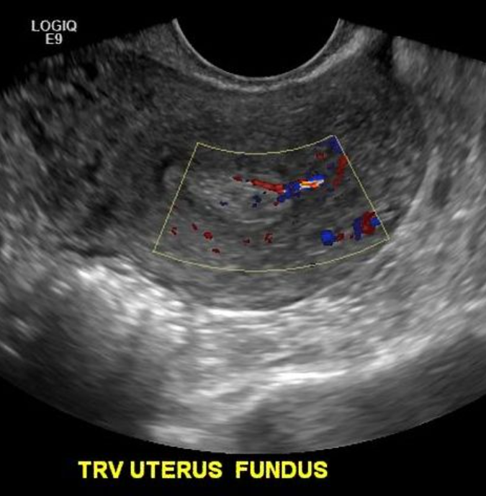
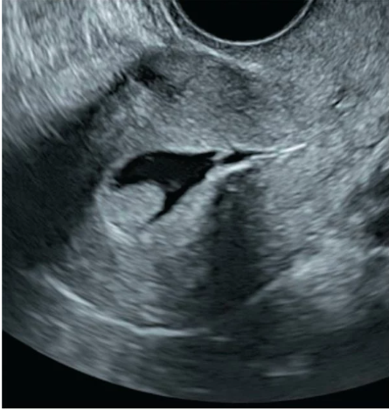
Polyps
Echogenic area, may have “cystic” area outline or saline infusion scan
Single vessel on Doppler
Radiopedia images

Slide 14
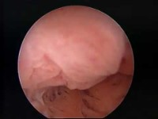

Slide 15
